Slide 1

SDLC
by- Varsini Ramakrishnan

Slide 2
What is SDLC ?
SDLC stands for Software Development Life Cycle, which is a structured process used for developing software applications.
It provides a systematic approach to software development and outlines various stages that ensure the development process is efficient, cost-effective, and produces high-quality software.

Slide 3
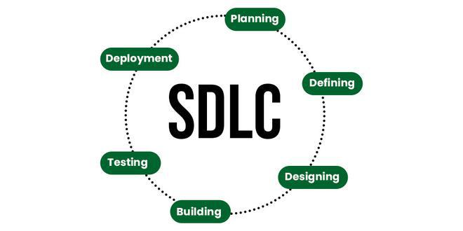
Phases of SDLC:

Slide 4
Types of SDLC models:
Waterfall
Each phase must begin after the completion of the before phase.
Iterative
Instead of starting with full requirements , we implement a set of requirements, test and then pinpoint new requirements.
Spiral
Combination of Waterfall and iterative which allows incremental releases of product in every iteration of the spiral.
V
It is known as validation and verification model, in which each phase is associated with a testing phase.

Slide 5
Which is best?
From my perspective V- model is best for doing a project.
In V- model we do testing in every phase , so there will be no issue of errors in the last minute

